Slide 1
Introduction to Programming Using Python

Slide 2
Instructor – Ray Smith raysmith@alum.mit.edu
Many years of Programming – engineering, scientific, financial
Commercial, Scientific, Systems Languages – C, C++, Perl, Java, Python, Assembly
NEW Areas - Games for young 3-8 years
Notes:
What would you like to know about me?

Slide 3
Objectives
Programming for non-programmers
Demonstrate Operations and Methods
Enable and energize new programmers
Learning by DOING
Notes:
What do you want from this course?
What do you want from programming?

Slide 4
Our Online Class – Using Zoom
If any background noise, please mute – minimizes cumulative noise
Disable own video – too many affects view
Can question via Chat – can be to ALL
Expecting Response: Start "QUESTION:"
Notes:
What do you want from this course?
What do you want from programming?

Slide 5
Introduction To Python – Session Progression
Lecture and practice: 1.5 Hours
Follow-up Questions: .5 Hours
Similar to Programming – This Course
Skips, Repeats / Revisits
Student Guideline:
If you know it – Have Patience
If confused / unsure – ASK QUESTIONS

Slide 6
Programming Telling the Computer What to Do
The language, PYTHON, is a way
Popular, Powerful, and EASY
Like most human languages – You don’t have to know all
to do a lot
Notes:
What should the computer do for you?
What should the programming language (Python) do?

Slide 7
Learn by DOING
Using Python's built in tool IDLE
Integrated Development and Learning Environment
Interactive execution of Python parts
Python Program editor and execution
Lots of documentation, examples, help
Notes:
Who hasn't downloaded python (from www.python.org)?

Slide 8
Blazing Introduction to Parts of Python
Run Python IDLE
Follow along with instructor
– copy, experiment, question
>>> 1 + 1
2
Notes:
Make shortcut?

Slide 9
Blazing Introduction – continued
>>>: IDLE shell prompt (to you the user)
# : start of comment to be ignored
Otherwise: printout from IDLE
>>> 1 + 1 # Comment on 1 + 1
Notes:
Offline self-guide file: exercises/python_introduction.py

Slide 10
Blazing Introduction Part 1 – Did we mention...
# Beginning comments
1+1, *, /, -, %, **, //, 1+2;3+4,
"a", 'b', """c""", '''d''',
"Ray" + " " + "Smith"
print(1, "one", 2, "two")
var_name = 1, a, b
NOT 1a, a b

Slide 11
Blazing Introduction Part 1B – Did we mention...
SyntaxError: cannot assign to literal
NameError: name 'a' is not defined
Traceback (most recent call last):
File "<pyshell#7>", line 1, in <module>
a
Tries to be helpful
Can't always guess
Tries to be exact

Slide 12
IDLE – Changed my mind.
Edit a line by "up arrow" to line, then press ENTER, then make changes
ALT-P(Cth-P on MAC) will "open" last command for changes
After changing code, press ENTER to execute changed command (twice if part of a compound statement)

Slide 13
Blazing Introduction Part 2 Python Code Files
Create file File ➔ New File (my_work.py)
… add text (#my_work.py)
File ➔ Save
Maybe in folder “classwork” ???
Reuse - File ➔ Save As ➔ …new name

Slide 14
Blazing Introduction Part 2 - continued Hello World! - You Try!
Write simple program (hello_world.py):
print("Hello World!")
print("My name is your name.")
Save file – File ➔ Save
OR File->Save As…
Run program – Run ➔ Run Module
Notes:
Howabout: File→File-->Recent Files (select my_work.py)
Then: File→Save As… (hello_world.py)

Slide 15
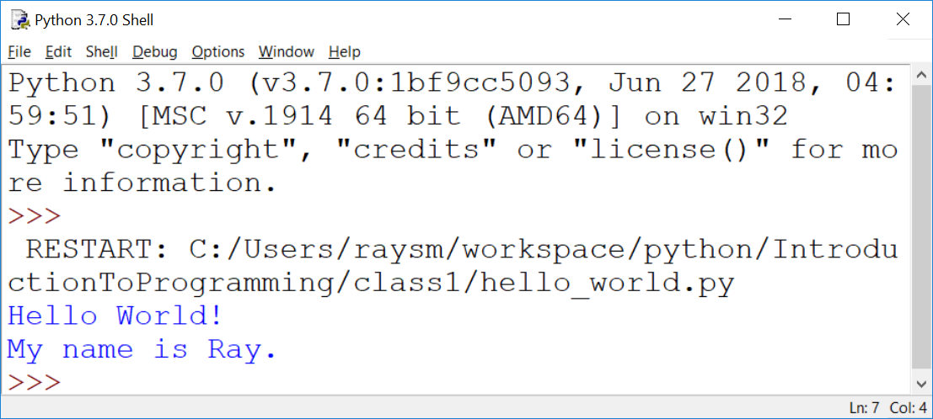
Hello World! – output – my example

Slide 16
Blazing Introduction Part 2 - continued Make a New Program – goodbye_world.py
"Goodbye World…"
Start with program closest to our goal
HINT: hello_world.py (File→Recent Files)
Save As… to new name BEFORE changing
Make changes creating new program
Run new program – Run ➔ Run Module
Notes:
How about goodbye_world.py ?

Slide 17
Blazing Introduction Part 3 – Did we mention...
if, else, elif, True, False,
a == b, a != b, a > b, a < b, a >= b
while, for, break, continue, range()

Slide 18
Blazing Introduction Part 4 – Adding lists...
list1 = [1,2]
print(list1)
list1.append(4)
print(list1)
for mem in list1:
print(mem)

Slide 19
Blazing Introduction Part 4 – Adding Dictionaries...
d1 = {'name1':1, 'n2':2}
print(d1)
d1['n1b'] = "1a"
print(d1)
for nm in d1:
print(nm, d1[nm])

Slide 20
Major Course Goal A Real Life Program YOU Will Create: Twenty Questions
… I’m thinking of a number …
Your program picks a number
Player guesses
Program tells if higher/lower
Program offers to play again
Notes:
What sort of programs are there? Could there be?
Calculators – financial, industrial
Games

Slide 21
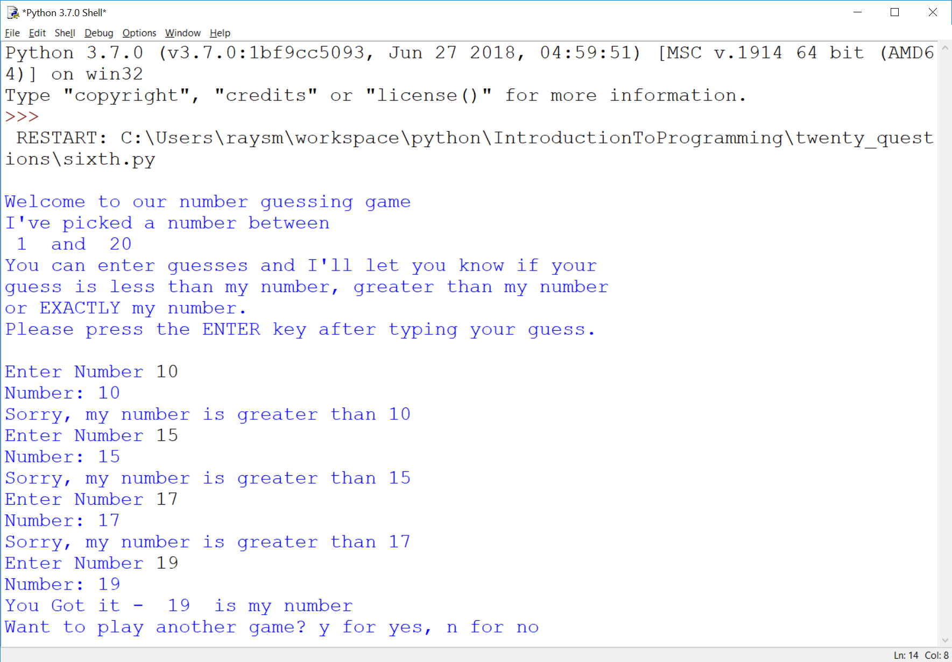
Here’s an example running
Notes:
What should we be able to do with programs?

Slide 22
Twenty Questions - continued
Programing → Iteration - improve along the way
Simplificaton also helps the user
Notes:
What sort of programs are there? Could there be?
Calculators – financial, industrial
Games

Slide 23
Guessing Game – Iteration 1
Create new file named “first.py”
Do the smallest part
Loop, asking number
Print number entered
Notes:
What is iteration?
Why iteration?
Any problems with iteration?
What's in a game?
goals
interaction
input
output
beginning, middle, end

Slide 24
Guessing Game – Iteration 1 - continued
Hints:
Place comments describing task
Use while True:
What variables?
Use string = input("…")

Slide 25
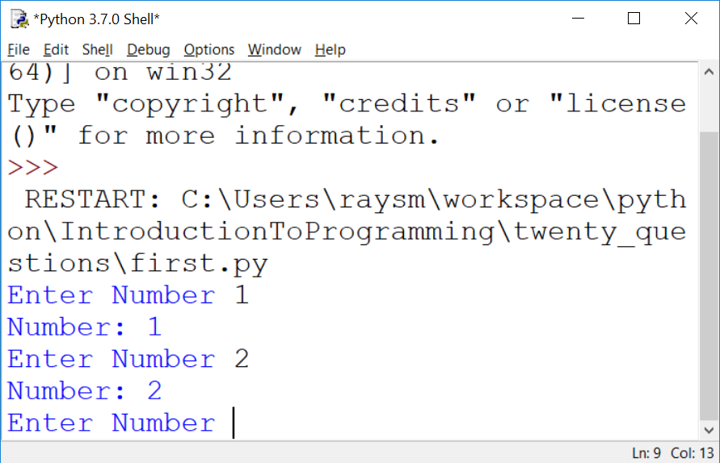
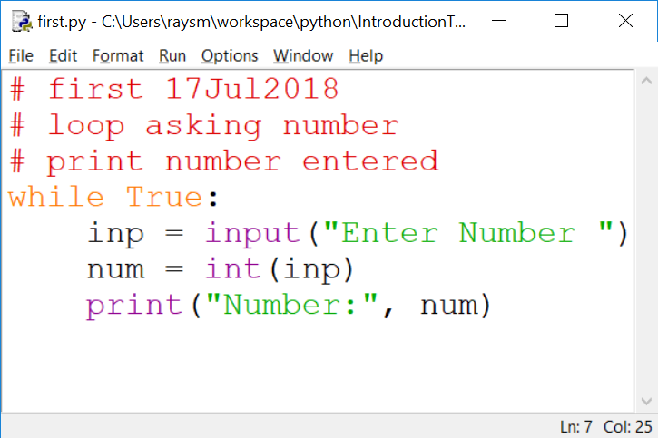
The First Iteration
Notes:
What do we get from doing this iteration?
learning
testing
early fun?
What does it cost us?

Slide 26
Programming Ideas - You will see a bit of Programming …
What is programming
Like
Not like
Programming Tools
Creating, Running
Improving through – copy, iteration

Slide 27
Python Rules and Mechanics - You will see more Python Details…
What is Python – A Programming Language
Comments
Values – Integer, Float, String
Variables – contain values
Computation / Arithmetic
Rules / Style

Slide 28
Still more Python Tools…
Decisions – if, else
Looping – while, for, break, continue
Grouping – indentation, functions, classes
Functions – parameters, returning
Data Structures – lists, dictionaries

Slide 29
Fundamental Programming Concepts – Computer == VERY Obedient Servant
Car Example
Most cars are alike
Does what you tell it – hopefully what you want
Same response every time – almost – e.g. forward / backward
Troubles - Car gets the blame…
Notes:
What does a car do for you?
What does a car do that you don't really need / want?
What is the most difficult thing about using a new car?

Slide 30
Activities – Similar to Programming
Abstract / Indirect
Cooking recipes
Travel directions
Assembly instructions
Physical – What you see is what you get
Construction - Roads, Buildings
Notes:
What's difficult about using recipes, maps, instructions?

Slide 31
Like Computer Programming, They do / have
Build once – use many times
Builder and user(s) often different
Building errors show up many times
Mistakes don't always show up immediately

Slide 32
Unlike Computer Programming, they have / are
Physical materials
Hard to copy
Hard to manipulate
Easy to see

Slide 33
What's Easy to Programming – No so physical
Creation / copying / moving is a snap
Don't wear out
Change easy
Work on new, while using old
Notes:
What makes programming easy/easier than work in the "physical" workplace?

Slide 34
What's Not Easy – because No so physical
Can't "see" it
Everything connected – unexpected consequences
Not easy to tell how close to done
Notes:
What is not so easy in programming?

Slide 35
Our Sandbox – IDLE Demonstration and Testing
https://www.python.org
Download latest python example: 3.7.0
Python shell
Documentation
IDE - editor, execution, debugger
Notes:
What would you like from a programming tool / helper?
IDLE can provide the environment for us to directly use Python to do things.
What's necessary?

Slide 36
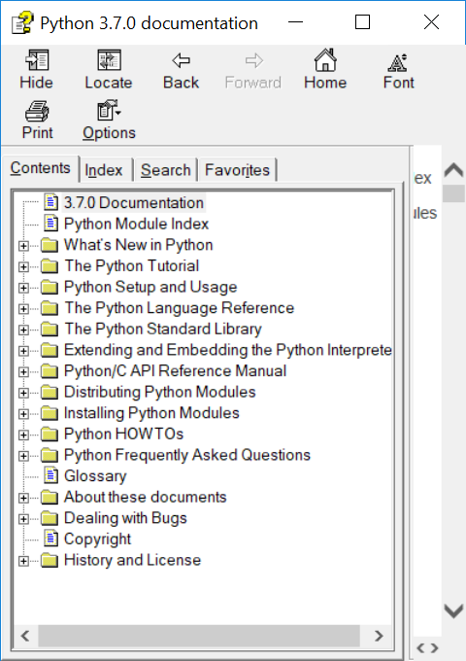
Documentation – Lots of Nice STUFF

Slide 37
IDLE – continued
Python Documentation:
Help ➔ Python Docs
Help on IDLE:
Help ➔ IDLE Help
Python Program Examples:
Help ➔ Turtle Demo
Notes:
What should IDLE do for you?

Slide 38
IDLE - A Quick Introduction to Python with a wordy offline guide file
A file with some beginning examples
open python_introduction.py
File → Open →… exercises → python_introduction.py

Slide 39
HOMEWORK / Review: python_introduction.py A wordy text file guide
Repeat each example from file
Try a couple of your own making
Don't worry about mistakes!
Notes:
First few lines are just information about this version of IDLE.
Plus, you can always type "help".

Slide 40
HOMEWORK / Review - continued: python_introduction.py
Python 3.7.4 (tags/v3.7.4:e09359112e, Jul 8 2019, 20:34:20) [MSC v.1916 64 bit (AMD64)] on win32
Type "help", "copyright", "credits" or "license()" for more information.
>>> # The following is an interactive introduction to basic Python concepts.
>>> # The text is pretty much as I typed it in to the Python IDLE shell,
>>> # and got printed out by the shell python shell evaluation.
Notes:
First few lines are just information about this version of IDLE.
Plus, you can always type "help".

Slide 41
Python_introduction.py…continued
>>> # You might get some useful practice by trying these examples on your
>>> # computer in the IDLE shell.
>>> # Lines with # are ignored by python from the # character to line end.
>>> # This introduction takes place within the python IDLE interpreter
Notes:
Repetition because some folks just use this file.
File was created while running IDLE and learning!

Slide 42
Python_introduction.py…continued
>>> # Lines starting with ">>> " can be directly typed, minus the ">>> ",
>>> # into IDLE
>>> # Text typed after the ">>> " is evaluated by python, and the value,
>>> # if any, is displayed.
>>> 1
1
>>> 1 + 2
3
Notes:
You may want to refer to this later for review.

Slide 43
A Second View
Programming Calisthenics
5 minutes - Using IDLE
Do One Example of EVERYTING you have seen
Don't worry about mistakes, errors – that's what IDLE is there for, errors are SOMETHING too
Done Early – Do Two Examples
E.g. 1+2, a=5, a**3, if a == 5

Slide 44
A Quick Review of Python
What is
>>>
# stuff here
1
1 + 2

Slide 45
A Quick Review of Python - continued
What is
A string
"here we are"
'there we go'
"It's the way"

Slide 46
A Quick Review of Python - continued
What is
"""
More and
More
"""

Slide 47
A Quick Review of Python - continue
What is
4;5;6
2+3,2*3

Slide 48
A Quick Review of Python - continued
How do we print a value?
On an IDLE line?
Using "print"

Slide 49
A Quick Review of Python - continued
How do we print:
"Hello World!"?
The sum of 1 plus 2?
Three strings "a", "bc", "def"?

Slide 50
A Quick Review of Python - continued
What is a variable?
Of what good is a variable?
Rules for naming a variable?
How do we:
Set up a variable?
Use a variable?

Slide 51
A Quick Review of Python - continued
What does this do:
first = "who"
print(first, "is on first")

Slide 52
A Quick Review of Python - continued
Legal variable names? Why?
a
tom
max_val
A21
target_hi __file__

Slide 53
A Quick Review Python - continued
Illegal variable names? Why?
1a
my name
short-stop
high.val

Slide 54
A Quick Review of Python - continued
What are some program flows?
What are some decisions to be made in program flow?
What are some Python decision making keywords?
How is each decision keyword used?

Slide 55
A Quick Review of Python - continued
Write a test that prints "a" if a is greater than b. Do we need something first?
Write a test that prints "a" if a is greater than b and "b" if not. Do we need something first?
Notes:
Variables need initialization before they may be used.

Slide 56
A Quick Review of Python - continued
Program Exercises
Write a loop that prints the numbers from 1 to 10.
Write a loop that prints the odd numbers from 1 to 9.
Notes:
Variables need initialization before they may be used.

Slide 57
Python Language - continued
Arithmetic almost like algebra class : +,-,*, >, >=, ==
BUT single “=” is for assignment
max_value = 20
value = value + 5
in = pr * (1+rate)**years

Slide 58
Python Language – print function
Prints one or more values
Separate values by commas (,)
print("Hello")
print("value: ", 10)
print("Maximum: ", max)

Slide 59
Python Language – print function - more
Inserting variables/values –
Formatted string (f-strings)
v_str = "string value"
v_int = 123
print(f"this has v_str={v_str}") print(f"this has v_int={v_int}")

Slide 60
Python Language – formatted string in action
>>> v_str = "string value"
>>> v_int = 123
>>> print(f"this has v_str={v_str}")
this has v_str=string value
>>> print(f"this has v_int={v_int}")
this has v_int=123
>>>

Slide 61
Python Language - Testing
“if” condition “:”
One or more indented lines
if value > max_value:
print("value", value, " is big")
print("Try less than", max_value)

Slide 62
Python Language - Looping
“while” condition “:”
One or more statements indented
to the SAME indentation
while value < max_value:
print("value ", value, " is OK")
value = value + 10
print("value is now", value)
Notes:
Why loops?
What should a loop have / do?

Slide 63
Exercise: “Times Tables” for 13 – 1x13, 2x13, …,13x13
Hints:
Create new file named “timestable.py”
Setup: name and set variables – nval = 13 first =1 last = nval n = first
Loop: while n <= last:
print(n, "x", nval, "=", n * nval)

Slide 64
Python Language – input function
Get user input
inp = input()
Prompt user first
inp = input("Please enter:")
Convert to Integer
nval = int(inp)
Notes:
Accepting input and dealing with it makes programs much more powerful than calculators or Television.

Slide 65
Exercise: “Times Tables” – with user giving number
Hints:
Use “timestable.py” as start
New file name = “timestableN.py”
Replace “13” with variable “nval”
Use inp = input("Enter mult:")
Use nval = int(inp)
Notes:
Why a NEW file name?
When do we create it?
WHY?

Slide 66
Exercise for LATER: “Times Tables” – Full table from 1x1 to NxN
Hints:
timestableN.py → timestableNbyN.py
How to do it by hand?
How many loops?
What are the variables?
Notes:
What are the issues?
What's the most difficult thing to achieve.

Slide 67
Second Iteration – A bit More
Set target value
Quit if number entered number equals target
Hints:
Start from first.py
Use break to quit while loop
Notes:
Why use File→Save As ("second.py") BEFORE any changes or additions?
HINT: What happens if, after one does a lot of additions, one does File→Save ?
What happens to the original "first.py" file contents?

Slide 68
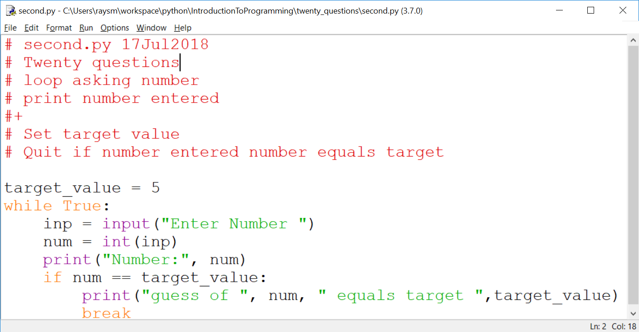
Second Iteration – continued

Slide 69
Thinking of Iterations
Think Features
Prioritize
Order most to least / easy to hard
Build to the next
Balance Big Bang! with Show it Now!
Show progress
Notes:
What is(are) the simplest idea(s)
Before anything else what does the program do?
What's the next?

Slide 70
Sample Program Iterations
First:
loop asking number
print number entered
Second:
Set target value
Quit if number entered number equals target

Slide 71
Think of the Iterations - continued
Third: Say if greater, less or equal
Fourth: Set target to random number
Fifth: Say goals, rules before start, including "a number between…"
Sixth: Ask player if they want another game – play multiple times
Seventh: Handle typos / illegal numbers

Slide 72
More Python – Variables Places to store values
Holds data, with a name
Eases the use/reuse our data/results
Names have rules:
Start with a letter (a-zA-Z_)
Followed by zero or more digits (0-9) or letters
OK - a, a1, my_variable, a2or3
NOT - 1, 1a, my-variable, "ray,smith"
Notes:
Why variables?
What are the issues with variables?

Slide 73
Python Language Guidelines with some exceptions
A statement is on ONE line
YES:
sum = 1 + 2
NO:
sum = 1 +
2
Parenthesized grouping may be on multiple lines
YES: sum = (1
+ 2)
Notes:
Note any place that has parentheses allows multi-line / indentation free formatting. Examples: arithmetic (….), print(….), and other functions.

Slide 74
Python Language Guidelines - continued
A group of statements:
Are executed in order
Must start at same indentation (from left)
BUT Parenthesized grouping may have any indentation within the parentheses
Notes:
Don't mix spaces and tabs
Stick with spaces
Editor can help

Slide 75
Python Language Guidelines - continued
YES:
start = 1
last = 3
increment = 1
NO:
start = 1
last = 3
increment = 1

Slide 76
Python import Bring in support
Importing brings in support
import random # for random numbers
from random import randint # just named
Examples will often include import statements
Notes:
Where do we find examples?
Internet
Documentation
Tutorials

Slide 77
Help is a click away Web searching
Try "python thingies …"
E.g. python random int between two numbers
Found: python - Generate random integers between 0 and 9 - Stack Overflow
GOT:
Try:
from random import randint
print(randint(0, 9))

Slide 78
Help is a click away Web searching - continued
Be brief – search algorithms are pretty good
First code may be wrong.
Someone saying Did this … didn't work
Stackoverflow.com
Question…
Answer…
Checkmark – Best liked answer
Answer…
Notes:
Internet is like a bunch of varied friends
Often correct but sometimes on a different track

Slide 79
Exercises - Iterations - continued
Do Iterations third, fourth
Third: Say if guess greater, less or equal
Fourth: Say goals, rules before start
Simple iterations are practice
Notes:
Use the previous iteration as a start to the next.
I'll go around and watch.
Raise had if a question.

Slide 80
Functions – Divide and Conquer
Hide the particulars
Delay consideration
Parts of the problem placed in functions

Slide 81
Functions – continued
Called (invoked/started) with name(comma-separated list of parameter values)
Returns result of operation
top = max(1,2,3)

Slide 82
Functions – continued
Function Definition – what it is going to do
Name – same style/restrictions as variable name
Parameters – data which is passed to the function
Comma-separated list

Slide 83
Functions – continued
Body – Where the actions are
Regular code
Uses data passed in parameters by parameter names

Slide 84
Functions – continued
def add2(value1, value2):
sum = value1 + value2
return sum
sum1 = add2(1,2) # sum1 gets 1+2
sum2 = add2(3,4) # sum2 gets 3+4
Notes:
Function Calling / Invocation
How do we call the function?
Called with the function name
Including parenthesized list of values
The values are passed to the function

Slide 85
Functions – continued Exercise – Special Product Function
Write a function product(factor1, factor2, factor3)
Returns the product of the values factor1, factor2, factor3.
Test it on the following:
.5, .4, .3; 1, 2, 3; -1, -1, -1;
Notes:
Function Calling / Invocation
How do we call the function?
Called with the function name
Including parenthesized list of values
The values are passed to the function

Slide 86
Functions – Keyword parameters
Optional – for seldom used
Any Order – avoids ordering confusion
Parameter names help understanding
myfun(key1=2, key2=7)
myfun(key1=4) # default - key2
myfun() # All defaulting
Notes:
Missing or misplaced function arguments are a big problem

Slide 87
Functions – Keyword parameters - continued
def myfun(key1=None, key2=7):
if key1 is None:
key1 = 5 # key1 not present
return key1 + key2
Notes:
What are the benefits of using None vs explicit value?
None is used to definitely indicate no value was supplied.
In this case – the call was made without the keyword parameter.

Slide 88
Functions – Keyword parameters – example – built-in function: print()
def print(*args, end="\n", sep=" ")
print("a", "b", sep=":") #different sep
Print("c","d", end="") #No end line
Exercise: Try using each print keyword

Slide 89
Functions – Keyword parameters – print() Exercise 2: – Print factors – factors.py
Prompt user for n
For numbers 1 to n, print factors
1: 1
2: 1,2 - factors on same line
3: 1, 3
4: 1,2,4
5: 1,5
6: 1,2,3,6

Slide 90
Functions – Keyword parameters – print Exercise
Improvements:
Omit 1, and number itself as factors
Only print numbers with at least one factor other than 1 or itself
Extra: Use "for" loop

Slide 91
Lists / Arrays – numbered / expandable
Named group of values
friends = ["tom", "dick", "jane"]
Access by position
print("1st, 3d:", friends[0], friends[2])
Add to end
friends.append("joe")
Notes:
First element at index: 0
Last element at index: len()-1
What sort of information would fit into a list?

Slide 92
Functions – an Example – Friends and Family
Assume a database or game or organization which includes friends
Needs utilities / worker functions
Add friends, list friends, check if one is a friend, …
Build up – friends_family/ friends_1.py, …
Notes:
First element at index: 0
Last element at index: len()-1
What sort of information would fit into a list?

Slide 93
Strings - Like a lists of characters - ALMOST
Assigned as a group, not via index
str_name = "abcdef"
NOT str_name[0] = "a"
Can be Accessed by index
if str_name[1] == "b":
print("Yep it’s the second character")
Notes:
What sort of information would fit into a string?

Slide 94
Strings - continued
Strings can't be changed in place (immutable)
But += works
name += last_name
Because x += y defined as x = x + y
name = name + last_name
Notes:
Not modifiable == immutable
Don't change – replace - a = (do stuff with a or parts of a)

Slide 95
Strings – continued - immutable
Not modifiable == immutable
Don't change – replace
str_name = "a" + str_name[1:]
Notes:
Not modifiable == immutable
Don't change – replace - a = (do stuff with a or parts of a)

Slide 96
Dictionary - Group of values - Access by name
trades_d = {
"painter" : "tom",
"landscaper" : "joe",
"plumber" : "kate"
}
print("landscaper:", trades_d["landscaper"])
Notes:
What sort of information would fit into a dictionary?

Slide 97
Dictionary - continued
for trade in trades_d:
print(trade, trades_d[trade])
for tra, who in trades_d.items():
print(tra, who)
trades_d["programmer"] = "ray"
Notes:
.

Slide 98
F-string – easer print formatting
building print strings
Put "f" before first quote
Place variable inside "{}"
t_nm = "Tom"
m_nm = "Mary"
print(f"tom={t_nm} mary={m_nm}")
Notes:
.

Slide 99
F-string – continued
{variable/expression:formatting}
:5d – integer 5 places
:5.2 – float 5 places, 2 dec pt
:>5 – string 5 places right justified
Notes:
.

Slide 100
F-string – continued
runners = { "tom" : { "count" : 5,
"time" : 3.8
},
"joe" : { "count" : 7,
"time" : 5.728
},
"mary" : { "count" : 10,
"time" : 7.62
}
}
Notes:
.

Slide 101
F-string – continued
# Print Heading
print(f"{'name':10}"
+ f" {'count':5}{'time':>5}")
for rname in runners:
info = runners[rname]
print(f"{rname:10} {info['count']:5d}"
+ f" {info['time']:5.3f}")
Notes:
.

Slide 102
F-string – continued
Output:
name count time
tom 5 3.800
joe 7 5.728
mary 10 7.620
Notes:
.

Slide 103
Files Data that stays around
Stream of bytes/characters "on disk"
Has a File Name
Open File – Create, if new
Read / Write sequentially
Close File
Notes:
File, as a named group of bytes is an abstraction.
Years ago the programmer needed to understand more about the structure.
Your Python program is a data file to some program(s).

Slide 104
Files - continued
Stream of bytes/characters "on disk"
Has a File Name
Open File – Create, if new
Read / Write sequentially
Close File
Notes:
File, as a named group of bytes is an abstraction.
Years ago the programmer needed to understand more about the structure.
Your Python program is a data file to some program(s).

Slide 105
Files – continued – Creating
Be careful with names- don't overwrite
#create_file.py
with open("my.txt", "a") as fout:
for i in range(1,5):
print("line %d" % i, file=fout)
Notes:
Open modes "r" –read, "w" – write, "a" - append

Slide 106
Files - continued
# read_file.py
file_name = "my.txt"
with open(file_name) as finp:
for line in finp:
print(line, end="")
Notes:
Note: print adds a newline at the end by default.
To avoid this, use the end="" parameter to replace the default newline with "".
e.g.

Slide 107
Files – continued – Exercises
Create your own two examples
1. create_file.py - Write and check
Save as read_file.py
2. read_file.py – Modify to do reading…
Notes:
What are the benefits of save / modify approach?
What are the pitfalls?

Slide 108
Files – continued Notes - A Simple Data Base
Goal:
Access to my data by name
Plan:
Save data in a text file
Search all lines for patterns e.g. name
Print lines where found

Slide 109
Notes - A Simple Data Base – Continued Details
Create two test files
test.notes – real short just a couple of lines
Joe Name Joe Smith
Joe Address 100 Main
Sam Name Sam Jones
Sam Address 20 Center
Watertown.notes – longer with more varied data

Slide 110
Notes - A Simple Data Base – Continued Details
Make "notes.py" program file.
Will display lines from a text file
that contain a given text string.

Slide 111
Notes - A Simple Data Base – Continued Iterations
1. Read specific file e.g. "test.notes"
print out all lines
2. Print only lines containing "student"
How to match lines ?
2.a Match (Student, STUDENT)
3. Prompt for, then accept file name, pattern
4. [Extra Credit] Multiple text patterns

Slide 112
Future – Python as "Glue"
Python can run other programs
E.g. notepad.exe
import subprocess as sp
fname = "notes.py"
sp.Popen(["notepad.exe", fname])

Slide 113
Finding python.exe from IDLE
Python 3.7.0 (v3.7.0:1bf9cc5093, Jun 27 2018, 04:59:51) [MSC v.1914 64 bit (AMD64)] on win32
Type "copyright", "credits" or "license()" for more information.
>>> import sys
>>> print(sys.executable)
C:\Users\raysm\AppData\Local\Programs\Python\Python37\pythonw.exe
>>>

